Slide 1
Exception & Utility Classes

Slide 2
Agenda
Exception Handling
Random Number
Enumerate
Using Regular Expression
File I/O
Encryption Functions

Slide 3
Exception Handling Introduction
Exceptions
Indicate problems that occur during a program’s execution
Occur infrequently
Exception handling
Can resolve exceptions
Allow a program to continue executing or
Notify the user of the problem and
Terminate the program in a controlled manner
Makes programs robust and fault-tolerant
Notes:
Exception handling is an in built mechanism in .NET framework to detect and handle run time errors.
The .NET framework contains lots of standard exceptions.
The exceptions are anomalies that occur during the execution of a program.
They can be because of user, logic or system errors.
If a user (programmer) do not provide a mechanism to handle these anomalies, the .NET run time environment provide a default mechanism, which terminates the program execution.
C# provides three keywords try, catch and finally to do exception handling.
The try encloses the statements that might throw an exception whereas catch handles an exception if one exists.
The finally can be used for doing any clean up process.
If any exception occurs inside the try block, the control transfers to the appropriate catch block and later to the finally block.
But in C#, both catch and finally blocks are optional.
The try block can exist either with one or more catch blocks or a finally block or with both catch and finally blocks.

Slide 4
Exception Handling General form of try-catch-finally
If any exception occurs inside the try block, the control transfers to the appropriate catch block and later to the finally block.
But in C#, both catch and finally blocks are optional.
The try block can exist either with one or more catch blocks or a finally block or with both catch and finally blocks.
try { // Statement which can cause an exception. } catch(Type x) { // Statements for handling the exception } finally { //Any cleanup code }

Slide 5
Exception Handling Samples 1/2
Program will compile but will show an error during execution
using System; class MyClient { public static void Main() { int x = 0; int div = 100/x; Console.WriteLine(div); } }
Notes:
Program will compile but will show an error during execution
using System; class MyClient { public static void Main() { int x = 0; int div = 100/x; Console.WriteLine(div); } }
The same program with exception handling
Finally block is present: the code inside the finally block will get also be executed.

Slide 6
Exception Handling Samples 2/2
With Exception Handling | Finally Block
using System; class MyClient { public static void Main() { int x = 0; int div = 0; try { div = 100/x; Console.WriteLine( "This line in not executed"); } catch(DivideByZeroException de) { Console.WriteLine("Exception occured"); } Console.WriteLine("Result is {0}",div); } } | using System; class MyClient { public static void Main() { int x = 0; int div = 0; try { div = 100/x; Console.WriteLine("Not executed line"); } catch(DivideByZeroException de) { Console.WriteLine("Exception occured"); } finally { Console.WriteLine("Finally Block"); } Console.WriteLine("Result is {0}",div); } }

Slide 7
Exception Handling Exception Handling Notes
using System;
class MyClient {
public static void Main() {
int x = 0;
int div = 0;
try {
div = 100 / x;
throw new DivideByZeroException(
"Invalid Division");
}
catch(DivideByZeroException e) {
Console.WriteLine(e);
}
Console.WriteLine("LAST STATEMENT");
}
}
Catch block can be optional
There can be multiple catch blocks
We can handle all exceptions with the Exception object
In C#, it is possible to throw an exception programmatically.
Notes:
Catch block can be optional: In this case, since there is no exception handling catch block, the execution will get terminated. But before the termination of the program statements inside the finally block will get executed. In C#, a try block must be followed by either a catch or finally block.
There can be multiple catch blocks: A try block can throw multiple exceptions, which can handle by using multiple catch blocks. Remember that more specialized catch block should come before a generalized one. Otherwise the compiler will show a compilation error.
Handling all exceptions with the Exception object:
using System;
class MyClient
{
public static void Main()
{
int x = 0;
int div = 0;
try
{
div = 100 / x;
Console.WriteLine("Not executed line");
}
catch (Exception e)
{
Console.WriteLine(e);
}
Console.WriteLine("Result is {0}", div);

Slide 8
Exception Handling User-defined Exceptions
using System;
class MyException : Exception
{
public MyException(string str)
{
Console.WriteLine("User defined exception");
}
}
class MyClient
{
public static void Main()
{
int x = 0;
int div = 0;
try
{
div = 100 / x;
throw new MyException("rajesh");
}
catch (Exception e)
{
Console.WriteLine("Exception caught here" + e.ToString());
}
Console.WriteLine("LAST STATEMENT");
}
}
In C#, it is possible to create our
own exception class. But Exception
must be the ultimate base class for
all exceptions in C#. So the user-defined
exception classes must inherit from
either Exception class or one of its
standard derived classes.

Slide 9
Exception Handling Exception Handling Guidelines 1/6
Exceptions should be used to communicate exceptional conditions.
Don't use them to communicate events that are expected, such as reaching the end of a file.
If there's a good predefined exception in the System namespace that describes the exception condition (one that will make sense to the users of the class) use that one rather than defining a new exception class, and put specific information in the message.

Slide 10
Exception Handling Exception Handling Guidelines 2/6
Do Not Catch Exceptions That You Cannot Handle.
try { intNumber = int.Parse(strNumber);
}
catch (Exception ex)
{ Console.WriteLine("Can't convert the string to " + "a number: " + ex.Message);}
try { intNumber = int.Parse(strNumber);
}
catch (ArgumentNullException ex)
{ Console.WriteLine(@"input is null"); }
catch( FormatException ex)
{ Console.WriteLine(@"Incorrect format"); }
You should never catch System.Exception or System.SystemException in a catch block because you could inadvertently hide run-time problems like Out Of Memory.

Slide 11
Exception Handling Exception Handling Guidelines 3/6
Use validation code to avoid unnecessary exceptions.
double result = 0;
try{
result = numerator/divisor; }
catch( System.Exception e)
{ result = System.Double.NaN; }
more efficient.
double result = 0;
if ( divisor != 0 ) result = numerator/divisor;
else result = System.Double.NaN;

Slide 12
Exception Handling Exception Handling Guidelines 4/6
Do Not Use Exceptions to Control Application Flow
static void ProductExists( string ProductId)
{ //... search for Product
if ( dr.Read(ProductId) ==0 ) // no record found, ask to create { throw( new Exception("Product Not found")); } }
static bool ProductExists( string ProductId)
{ //... search for Product
if ( dr.Read(ProductId) ==0 ) // no record found, ask to create { return false; } . . .
}
Notes:
Throwing exceptions is expensive. Do not use exceptions to control application flow. If you can reasonably expect a sequence of events to happen in the normal course of running code, you probably should not throw any exceptions in that scenario.
The following code throws an exception inappropriately, when a supplied product is not found.
static void ProductExists( string ProductId) { //... search for Product if ( dr.Read(ProductId) ==0 ) // no record found, ask to create { throw( new Exception("Product Not found")); } } Because not finding a product is an expected condition, refactor the code to return a value that indicates the result of the method's execution. The following code uses a return value to indicate whether the customer account was found.
static bool ProductExists( string ProductId) { //... search for Product if ( dr.Read(ProductId) ==0 ) // no record found, ask to create { return false; } . . . } Returning error information using an enumerated type instead of throwing an exception is another commonly used programming technique in performance-critical code paths and methods.

Slide 13
Exception Handling Exception Handling Guidelines 5/6
The following code ensures that the connection is always closed.
SqlConnection conn = new SqlConnection("...");
try { conn.Open();
//.Do some operation that might cause an exception
// Calling Close as early as possible conn.Close();
// ... other potentially long operations
} Finally
{ if (conn.State==ConnectionState.Open) conn.Close(); // ensure that the connection is closed }
Notes:
Notice that Close is called inside the try block and in the finally block. Calling Close twice does not cause an exception. Calling Close inside the try block allows the connection to be released quickly so that the underlying resources can be reused. The finally block ensures that the connection closes if an exception is thrown and the try block fails to complete. The duplicated call to Close is a good idea if there is other significant work in the try block, as in this example.

Slide 14
Exception Handling Exception Handling Guidelines 6/6
The cost of using throw to rethrow an existing exception is approximately the same as throwing a new exception. In the following code, there is no savings from rethrowing the existing exception.
try { // do something that may throw an exception } catch (Exception e) { // do something with e throw; }
Do not catch exceptions that you do not know how to handle and then fail to propagate the exception
try {
// exception generating code
} catch(Exception e) {
// Do nothing
}
Notes:
Notice that Close is called inside the try block and in the finally block. Calling Close twice does not cause an exception. Calling Close inside the try block allows the connection to be released quickly so that the underlying resources can be reused. The finally block ensures that the connection closes if an exception is thrown and the try block fails to complete. The duplicated call to Close is a good idea if there is other significant work in the try block, as in this example.

Slide 15
Random Number
using System.Random;
Random rdm = new Random();
int i = rdm.Next(10, 100); // A random integer between 10 and 99
i = rdm.Next(100); // Equivalent Next(0, 100)
i = rdm.Next(); // Equivalent Next(0, Int32.MaxValue)
double d = rdm.NextDouble(); // A random double greater or equal
// zero and less than 1.0
byte[] bar = new byte[10];
rdm.NextBytes(bar); // an array of byte numbers

Slide 16
Enumerate
// Default starts from Zero
enum WorkingDays {Monday, Tuesday, Wednesday, Thursday, Friday};
int i = (int)WorkingDays.Monday; // i = 0
// Assigned value
enum WorkingDays {…, Wednesday = 5, …};
int i = (int)WorkingDays.Friday; // i = 7
// Using
WorkingDays wd = WorkingDays.Tuesday;
switch (wd){…}
string n = Enum.GetName(typeof(WorkingDays), 6);
n = wd.ToString(); // n = "Tuesday"

Slide 17
Using Regular Expression
A regular expression is a pattern that could be matched against an input text. The .Net framework provides a regular expression engine that allows such matching. A pattern consists of one or more character literals, operators, or constructs.
Constructs for Defining Regular Expressions
Character escapes
Character classes
Anchors
Grouping constructs
Quantifiers
Backreference constructs
Alternation constructs
Substitutions
Miscellaneous constructs

Slide 18
Using Regular Expression
using System.Text.RegularExpressions;
string emailpattern = @"\w+(.\w+)*@\w+.(\w{2,})(.\w{2,})*";
Regex regx = new Regex(emailpattern);
string email = "fwa.ctc@fsoft.com.vn";
bool b = regx.IsMatch(email); // Ignore the position
Match m = regx.Match(email); // get more information
b = m.Success; // true
int i = m.Index; // the position of the 1st matched character
string textfound = m.Value; // "fwa.ctc@fsoft.com.vn" in this case
email = "fwa@fsoft.com.vn, fpt@fsoft.com.vn";
MatchCollection ms = regx.Matches(email); // multiple results
foreach (Match m1 in ms){
i = m1.Index; // 0 then 18
textfound = m1.Value; // fwa@fsoft.com.vn then fpt@fsoft.com.vn
// m1.Success is always true in collection
}
// Removes whitespace between a word character and . or ,
Regex rgx = new Regex(@"(\w)(\s+)([.,])");
string s = rgx.Replace("sdfd . sdfgdg ,", @"$1$3");

Slide 19
LINQ for Object
LINQ is a methodology that simplifies and unifies the implementation of any kind of data access. LINQ does not force you to use a specific architecture
Type of Linq: Linq to object, linq to SQL, linq to Entity, Linq to ADO.NET,...
LINQ to Objects has the goal of manipulating collections of objects

Slide 20
LINQ for Object
// Specify the data source.
int[] scores = {97, 92, 81, 60};
// Define the query expression.
IEnumerable<int> scoreQuery =
from score in scores
where score > 80
select score;
// Execute the query.
foreach (int i in scoreQuery){
Console.Write(i + " ");
}
// Output: 97 92 81
Notes:
LINQ A query is executed in a foreach statement, and foreach requires IEnumerable or IEnumerable<T>.

Slide 21
File I/O
Why read or write to the file system?
• Show existing data to user • Integrate user-provided data • Serialize objects out of memory • Persist data across sessions • Determine environment configuration

Slide 22
File IO
How do we write to files?
• This is simplified with Framework methods; open / shut — FiIe.WriteAllText / ReadAllText • Open for reading to keep open and keep writing • Open as stream for large payloads and realtime processing

Slide 23
File IO Plan text file I/O
// Type
using System.IO.StreamReader;
using System.IO.StreamWriter;
try{
// File exist:
if (File.Exists("a.txt")){
// Open
StreamReader input = new StreamReader("a.txt");
StreamWriter output = new StreamWriter ("b.txt");
// Repeat access until end of input
string line;
while ((line = input.ReadLine()) == null){
output.WriteLine(line);
}
//Close
input.Close(); output.Close();
}
} catch (IOException e){
System.Console.WriteLine(e.Message);
}

Slide 24
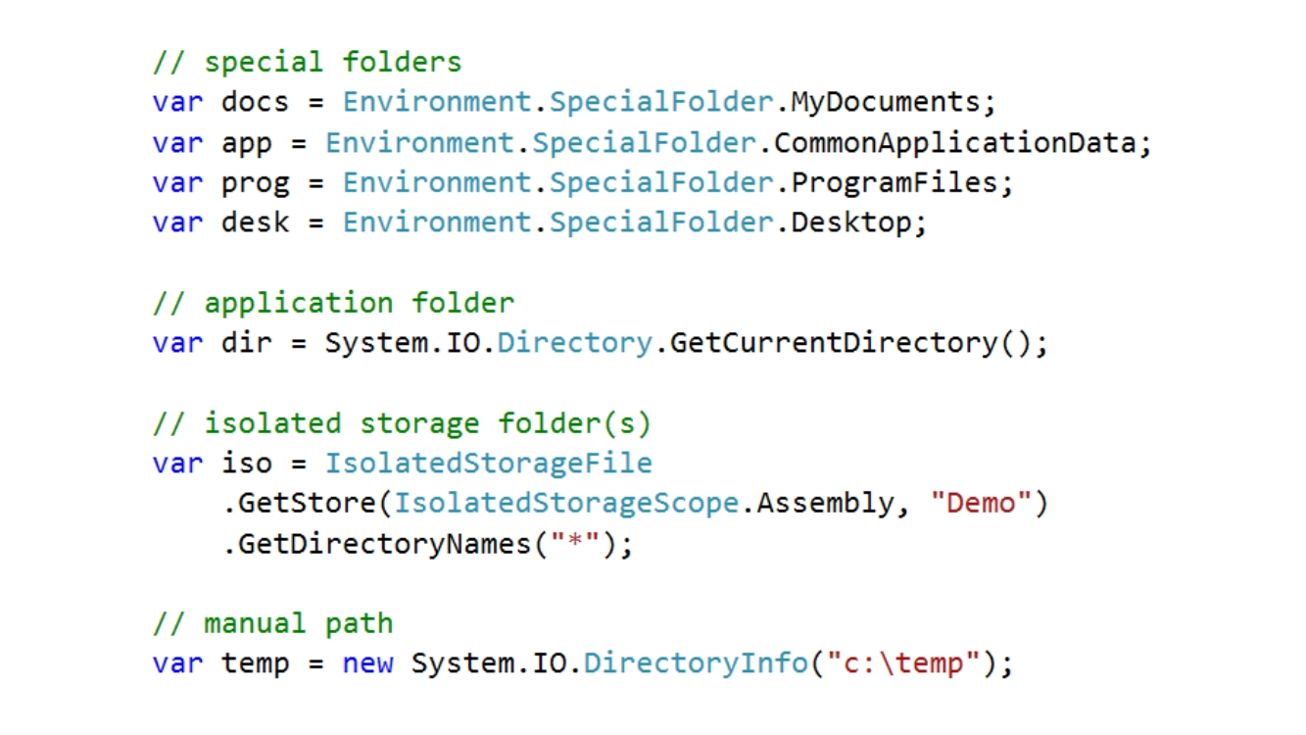
File IO
Special folder

Slide 25
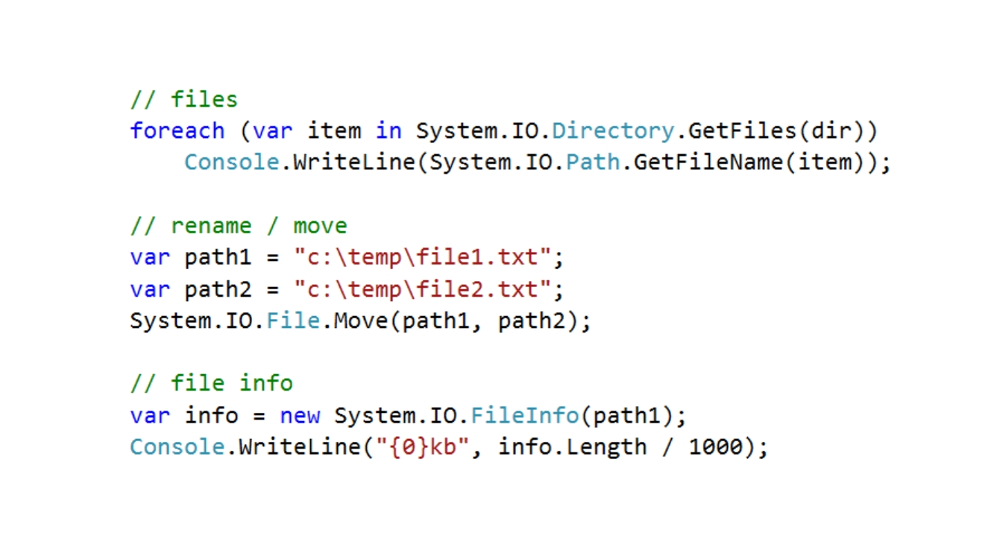
File IO
Files system accessing

Slide 26
Encryption Functions
What is encryption
• An encryption algorithm makes data unreadable to any person or system until the associated decryption algorithm is applied. — Encryption does not hide data; it makes it unreadable — Encryption is not the same as compression • Types of encryption — File Encryption — Windows Data Protection — Hashing, used for signing and validating — Symmetric and Asymmetric

Slide 27
Encryption Functions
Encryption Methods
• File Encryption — Encrypts and decrypts files — Fast to encrypt/decrypt — Based on user credentials • Windows Data Protection — Encrypts and decrypts byte[] — Fast to encrypt/decrypt — Based on user credentials

Slide 28
Encryption Functions
Hashing DEMO
• One-way encryption • Common algorithms: — MD5 (generates a 16 character hash than can be stored in a Guid) — SHA (SHA1, SHA256, SHA384, SHA512) • Fast (depending on chosen algorithm) • Used for storing passwords, comparing files, data corruption/tamper checking — Use SHA256 or greater for passwords or other sensitive data

Slide 29
Encryption Functions
Symmetric Encryption DEMO
• One key is used for both encryption and decryption • Faster than asymmetric encryption • Cryptography namespace includes five symmetric algorithms: — Aes (recommended) —DES —RC2 —RndaeI — TripeDES

Slide 30
Encryption Functions
Asymmetric/Public Key Encryption DEMO
• One key is used for encryption and another key for decryption • Commonly used for digital signatures • Cryptography namespace includes four asymmetric algorithms: -DSA — ECDiffieHellman —ECDsa — RSA (most popular)

Slide 31


